Slide 1
CS 352 | Heuristic Evaluation Assignment
Abigail Lam
Oregon State University Department of Chemistry Website
https://chemistry.oregonstate.edu/
Notes:
First, click File, Make a Copy to add your own, editable copy of the slide deck to your Google Drive.
Then, replace the Bullet Point Text on this slide
with your full name;
the name of the Website/App/Physical Device you reviewed and;
the Website/App URL.
Once you are ready to submit your assignment, click File, Download, PDF Document and submit that PDF file in Canvas.

Slide 2
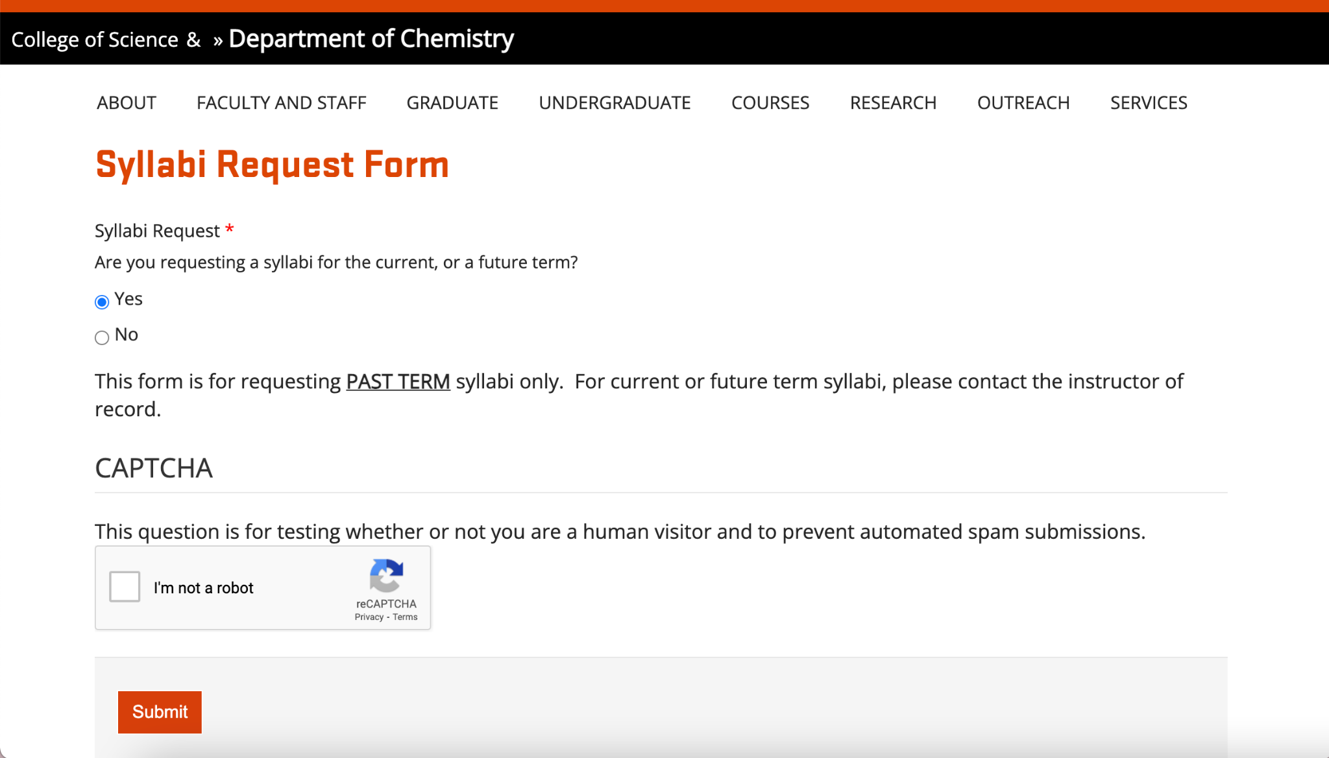
#5: Error Prevention
When using the syllabi request form, the first question that is asked is if the user is requesting a syllabi for the current of future term with the option of yes or no. When clicking yes, it gives the user a message that the form is for past terms only and to contact the instructor for current or future terms. The website then gives the option to submit the form.
This issue falls under error prevention because the message that appears when clicking yes should be more apparent, possibly a pop-up message that forces the user to acknowledge the issue. The form should not allow the user to submit as no information has been entered. Additionally, there is not way to undo the form unless you reload the page.
This is a major usability problem because it allows the user to submit the form regardless of if there is information entered. The submitted form is most likely empty on the administrative side. The user also is not able to request a syllabi unless they refresh the page and restart.
3 = Major Usability Problem
Notes:
Review a design against Nielsen’s 10 Heuristics.
Once you find an issue, take a photo or make a screenshot clearly illustrating the observed or experienced issue and place the photo/screenshot in the left, white panel.
Enter on the right panel:
The full name of the heuristic which was violated.
An explanation why the heuristic is violated:
Explain the issue experienced and what happened.
Then relate that issue to the identified heuristic, which you named on top.
Based on that and your reasoning, conclude why this is a i) cosmetic, ii) minor, iii) major problem or even a iv) usability catastrophe (ignore cosmetic problems).
Use around 150 words minimum for your explanation
The text will resize automatically once you start writing.
The assessed severity of the Problem.
Nielsen’s 10 heuristics: https://www.nngroup.com/articles/ten-usability-heuristics/
Nielsen’s severity ratings: https://www.nngroup.com/articles/how-to-rate-the-severity-of-usability-problems/
This is an slide you can use to edit and create your first heuristic assessment.

Slide 3
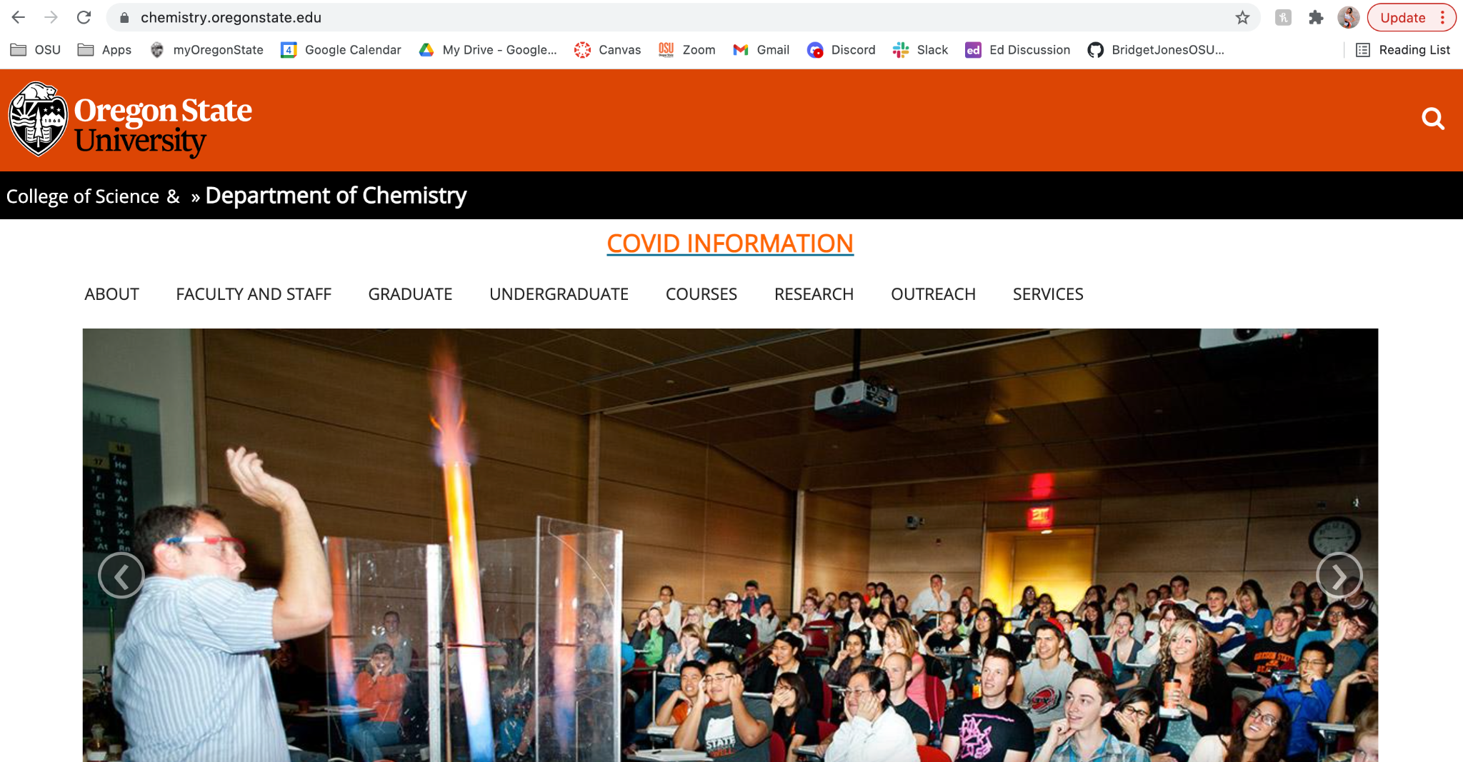
#8: Aesthetic and minimalist design
When navigating to the home page, the only thing that shows is the top drop-down menu and half of a picture in a slideshow. There is no headline or featured information shown on the first view of the webpage. When scrolling down, we are able to determine that the picture has a headline but at the bottom, invisible to the user unless they scroll further down. Additionally, the page then has a little blurb about the Department of Chemistry but the goes into “Read more”. Next, there are upcoming events and the department’s Twitter feed.
This issue falls under aesthetic and minimalist design because new stories are not relevant nor most important when navigating to the department’s website. When navigating to an educational institution website, most likely users are looking for information about the department or courses. Additionally, the website is not aesthetically pleasing as the main pictures are cut off on certain devices such as a wide-screened laptop.
This is a cosmetic problem and is low priority since users are still able to scroll through the page and navigate.
1 = Cosmetic Problem Only
Notes:
Review a design against Nielsen’s 10 Heuristics.
Once you find an issue, take a photo or make a screenshot clearly illustrating the observed or experienced issue and place the photo/screenshot in the left, white panel.
Enter on the right panel:
The full name of the heuristic which was violated.
An explanation why the heuristic is violated:
Explain the issue experienced and what happened.
Then relate that issue to the identified heuristic, which you named on top.
Based on that and your reasoning, conclude why this is a i) cosmetic, ii) minor, iii) major problem or even a iv) usability catastrophe (ignore cosmetic problems).
Use around 150 words minimum for your explanation
The text will resize automatically once you start writing.
The assessed severity of the Problem.
Nielsen’s 10 heuristics: https://www.nngroup.com/articles/ten-usability-heuristics/
Nielsen’s severity ratings: https://www.nngroup.com/articles/how-to-rate-the-severity-of-usability-problems/
This is an slide you can use to edit and create your second heuristic assessment.

Slide 4
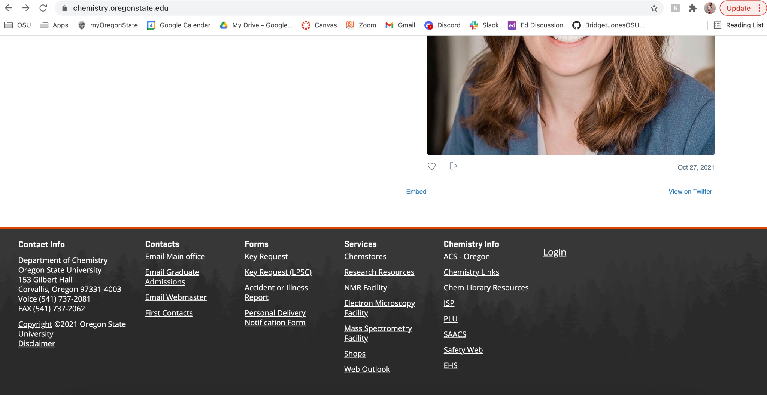
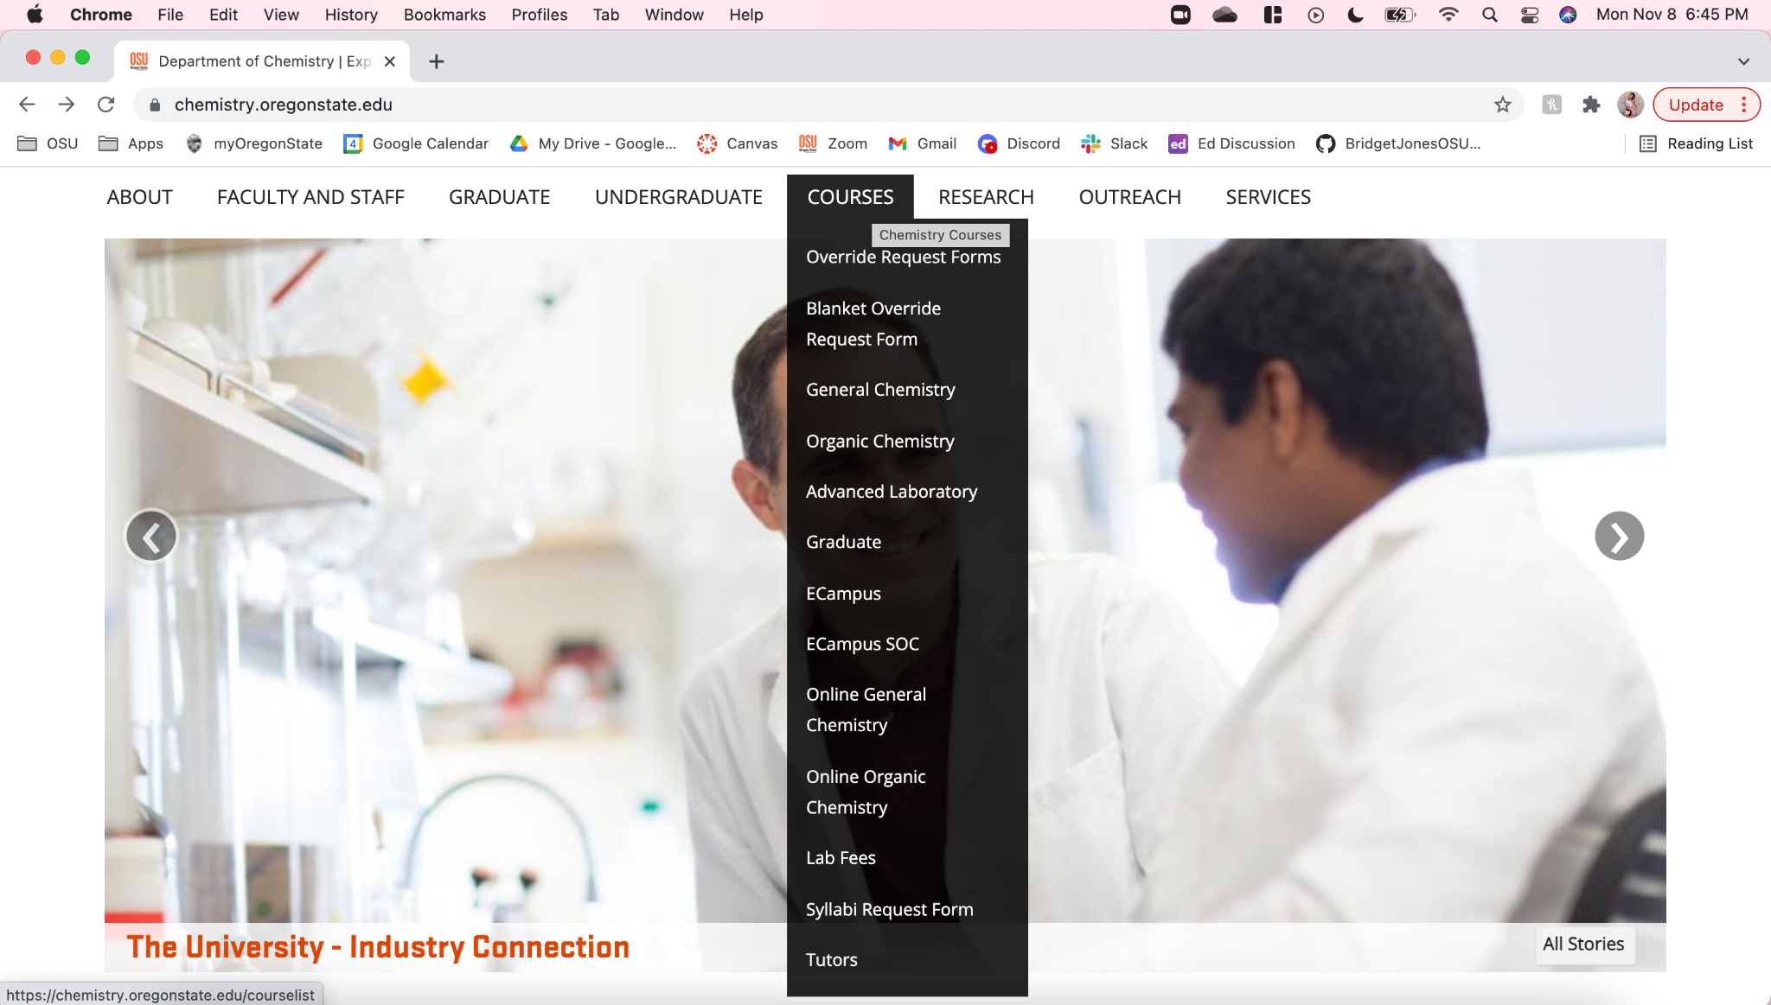
#4: Consistency and standards
When looking for forms, there is a section on the bottom footer of the page to access forms. However, there are also forms located under the top drop-down bar. Since the drop-down bar is organized alphabetically, two of the forms are at the top of the drop-down while another is at the bottom. Additionally, users can only see the bottom form if they scroll further down.
This issue falls under consistency and standards. Since these are also forms, there should be consistency on where they are located. Users may assume since there is a section labeled “forms” that all forms are located there. Cognitively, if they are not located in this section, users may think the forms do not exist rather than looking in other places on the website for them. Additionally, there could even be a separate page that users are able to locate where all of the forms are.
This is a minor usability problem and should have low priority because while the form’s locations are not consistent, they are still locatable. The user may have to do more searching through the website for them but they are there.
2 = Minor Usability Problem
Notes:
Review a design against Nielsen’s 10 Heuristics.
Once you find an issue, take a photo or make a screenshot clearly illustrating the observed or experienced issue and place the photo/screenshot in the left, white panel.
Enter on the right panel:
The full name of the heuristic which was violated.
An explanation why the heuristic is violated:
Explain the issue experienced and what happened.
Then relate that issue to the identified heuristic, which you named on top.
Based on that and your reasoning, conclude why this is a i) cosmetic, ii) minor, iii) major problem or even a iv) usability catastrophe (ignore cosmetic problems).
Use around 150 words minimum for your explanation
The text will resize automatically once you start writing.
The assessed severity of the Problem.
Nielsen’s 10 heuristics: https://www.nngroup.com/articles/ten-usability-heuristics/
Nielsen’s severity ratings: https://www.nngroup.com/articles/how-to-rate-the-severity-of-usability-problems/
This is an slide you can use to edit and create your third heuristic assessment.

Slide 5
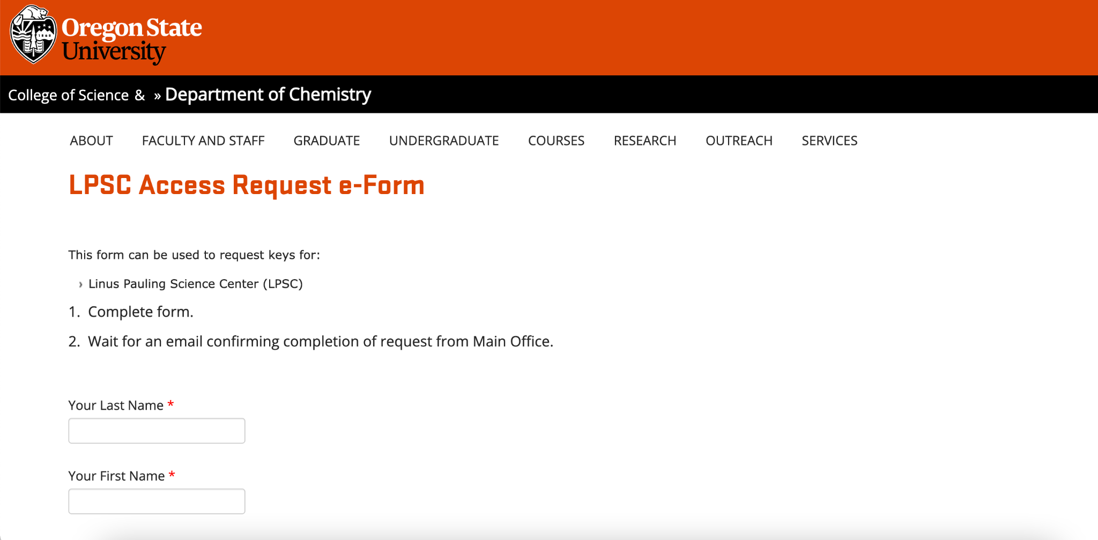
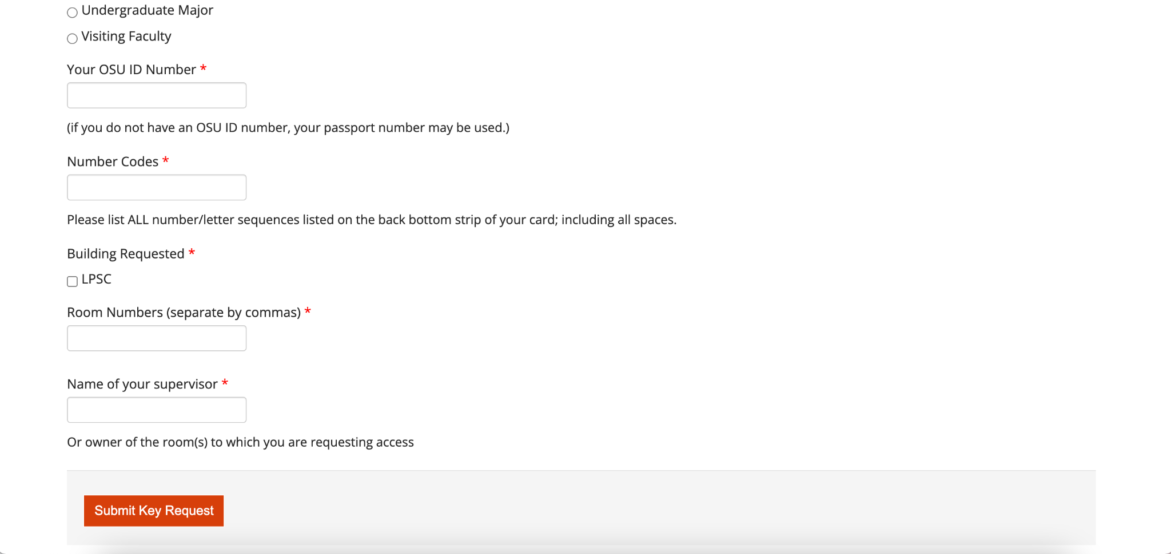
#10: Help and documentation
While using Access Request forms, while there are instructions, they are vague and not descriptive if the user did not know how to complete it. This access form is specifically for LPSC, one of Oregon State University’s buildings. At the top of the form, it states this form is used to request keys for Linus Pauling Science Center however, does not give information for if the user wants to request for a different building. The formatting is also not clear because there is a title of what the field should contain, an empty field box, and then the instructions under the box. Additionally, there is a section that asks for “Number Codes” and requests all numbers and letters are listed. However, if a user did not know what a number code is, they may put the wrong information.
This issue falls under help and documentation because there needs to be instructions that guides the user step-by-step on how to complete the form with the correct information. For example, the instructions need to be above the empty fields since the user would need to see the instructions before entering information in. Additionally, more ambiguous instructions could provide examples. In terms of the number code section, an visual example of where it is located could be provided.
This is a major usability problem because if a user is not clear on what information to enter, the whole form could be submitted wrong. The instructions need to be concrete and clear.
3 = Major Usability Problem
Notes:
Review a design against Nielsen’s 10 Heuristics.
Once you find an issue, take a photo or make a screenshot clearly illustrating the observed or experienced issue and place the photo/screenshot in the left, white panel.
Enter on the right panel:
The full name of the heuristic which was violated.
An explanation why the heuristic is violated:
Explain the issue experienced and what happened.
Then relate that issue to the identified heuristic, which you named on top.
Based on that and your reasoning, conclude why this is a i) cosmetic, ii) minor, iii) major problem or even a iv) usability catastrophe (ignore cosmetic problems).
Use around 150 words minimum for your explanation
The text will resize automatically once you start writing.
The assessed severity of the Problem.
Nielsen’s 10 heuristics: https://www.nngroup.com/articles/ten-usability-heuristics/
Nielsen’s severity ratings: https://www.nngroup.com/articles/how-to-rate-the-severity-of-usability-problems/
This is an slide you can use to edit and create your fourth heuristic assessment.

